Slide 1
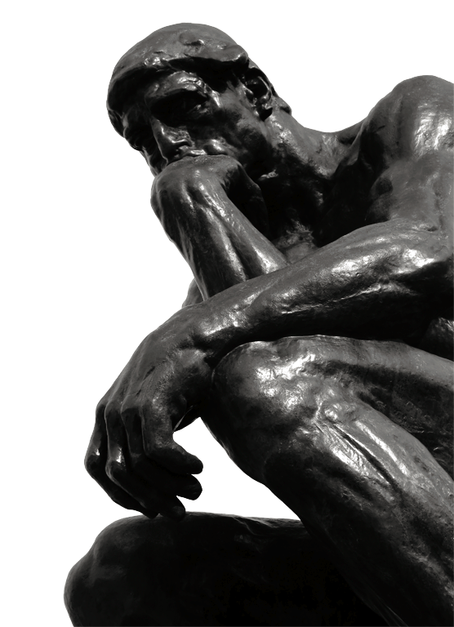
^{The unexamined life}
^{is not worth living.}
—Socrates
There is an ancient book that
answers life’s difficult questions.
Join Worldview Rethink and take
time to examine the world’s
bestseller—the Holy Bible.
Date:
Time:
worldviewrethink.com

Slide 2
^{The unexamined life}
^{is not worth living.}
—Socrates
There is an ancient book that
answers life’s difficult questions.
Join Worldview Rethink and take
time to examine the world’s
bestseller—the Holy Bible.
Venue:
Contact:
worldviewrethink.com

